Slide 1


Department of Computer Science and Engineering
EMPOWERING CONSTRUCTION WORKERS SAFETY THROUGH REAL TIME
PROTECTIVE EQUIPMENT MONITORING AND ALARM SYSTEM
Supervisior
Dr. Senthil Pandi S
Assistant Professor
B21A2425C17
210701150 Manojkanna K
210701153 Maria Joshin M

Slide 2
Introduction
Worker safety is a critical concern in the construction industry, where high accident rates and fatalities underscore the urgent need for robust monitoring systems. Despite established safety standards, many workers neglect to wear essential Personal Protective Equipment (PPE) such as masks, vests, and helmets, leading to severe injuries or fatalities. Factors like discomfort, forgetfulness, and inadequate supervision contribute to this non-compliance, highlighting a lack of a strong safety culture. Traditional manual monitoring methods place a heavy burden on supervisors, making it difficult to ensure consistent PPE adherence, often resulting in reactive rather than proactive safety measures. To address these challenges, a real-time monitoring system utilizing advanced detection algorithms is proposed. This system ensures continuous PPE compliance by triggering instant audio alarms when workers are found without required safety gear, fostering accountability and safety awareness. By providing real-time feedback and reducing the supervisory workload, the system enhances overall safety management, enabling supervisors to focus on broader safety concerns

Slide 3
Problem Statement and Motivation
Safety management methods are often reactive, relying on manual checks and post-incident interventions, which can lead to accidents and injuries due to non-compliance with safety regulations. The absence of a system that can continuously and automatically detect whether workers are wearing essential protective gear, such as hats, masks, and vests, increases the potential for hazards.
The motivation for this project is to improve construction site safety by overcoming the inefficiencies of manual inspections, which often miss safety violations. The project aims to create an automated system that can detect non-compliance with safety gear in real-time and provide immediate alerts.

Slide 4
Objectives
Ensure consistent PPE compliance among construction workers to reduce accidents and fatalities.
Develop a real-time monitoring system using the YOLOv8 model for accurate safety detection.
Provide immediate alerts for violations, enabling prompt corrective actions on-site.
Promote a culture of accountability and prioritize worker health and safety in diverse environments.

Slide 5
Abstract
Failure to wear personal protective equipment (PPE) such as masks, safety vests, and helmets has resulted in tragic accidents and needless deaths in the construction sector. Due to careless safety violations, numerous employees have suffered serious injuries or tragically lost their lives, underscoring the essential need for efficient monitoring systems that put their health first. By developing a real-time system that guarantees employees are wearing their necessary safety gear while on the job, our initiative aims to address this pressing issue. The method encourages a proactive attitude to safety by precisely determining if employees are wearing the required PPE, fostering an atmosphere where each person feels accountable for their own and their coworkers' safety. An audible alarm will ring and prompt fast action if a worker is discovered to be lacking the necessary personal protective equipment. This creative approach seeks to promote a culture of care and accountability on building sites in addition to increasing awareness of safety compliance. This project aims to create a safer workplace by drastically lowering the risks associated with insufficient PPE usage. This will ensure that every worker can safely return home to their families at the end of each day, demonstrating a commitment to life safety and promoting a safe working environment.

Slide 6
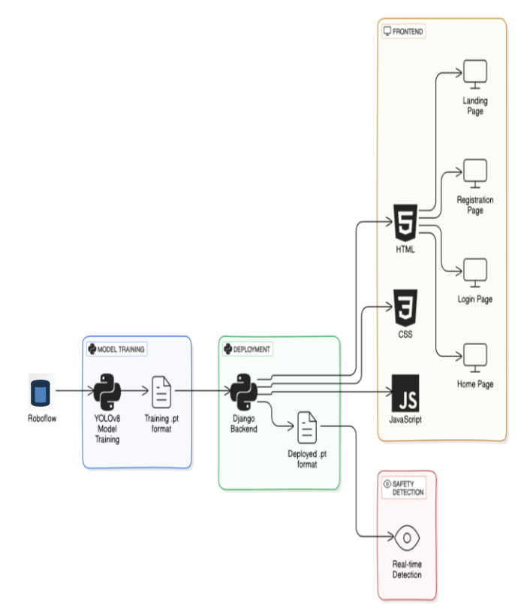
System Architecture

Slide 7
List of Modules
Data Collection and augmentation
Model Training
3.Obtaining model.pt
4.Creating User Interface
5.Detection and Alarm System

Slide 8
Functional Description for each modules
Data Collection and Augmentation: This module involves gathering a diverse dataset of images depicting workers with and without PPE (e.g., helmets, vests, masks). Data augmentation techniques such as Image flipping, Rotating images, Changing the brightness and color saturation are applied to simulate real-world variations, improving model robustness and generalization.
Model Training: The augmented dataset is used to train the YOLOv8 model for detecting PPE compliance. Ensuring the model accurately distinguishes between compliant and non-compliant workers in various scenarios.
Obtaining model.pt: After training, the model is evaluated, and the best-performing weights are saved in the .pt format. This file represents the trained YOLOv8 model, which is ready for deployment in real-time detection tasks.

Slide 9
Functional Description for each modules
Creating User Interface: The user interface, built with Django, HTML, CSS, and JavaScript, serves as the primary access point for system functions. Designed for safety personnel and site supervisors, it ensures secure login and prevents unauthorized access. The "Detect" button activates the webcam for real-time PPE compliance monitoring. This intuitive UI transforms devices into monitoring hubs, enhancing usability and accessibility.
Detection and Alarm System: The system's user interface, developed using Django, HTML, CSS, and JavaScript, seamlessly integrates real-time detection functionality. Supervisors can securely log in and activate the webcam via the "Detect" button, triggering the YOLOv8 model to analyze live video feeds for PPE compliance. An audio alarm alerts workers to violations, fostering a proactive safety culture. This integration ensures accessibility, secure data management, and enhanced monitoring for construction site safety.

Slide 10
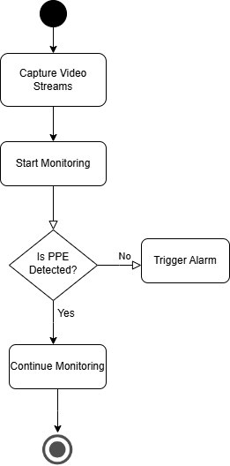
Activity Diagram

Slide 11
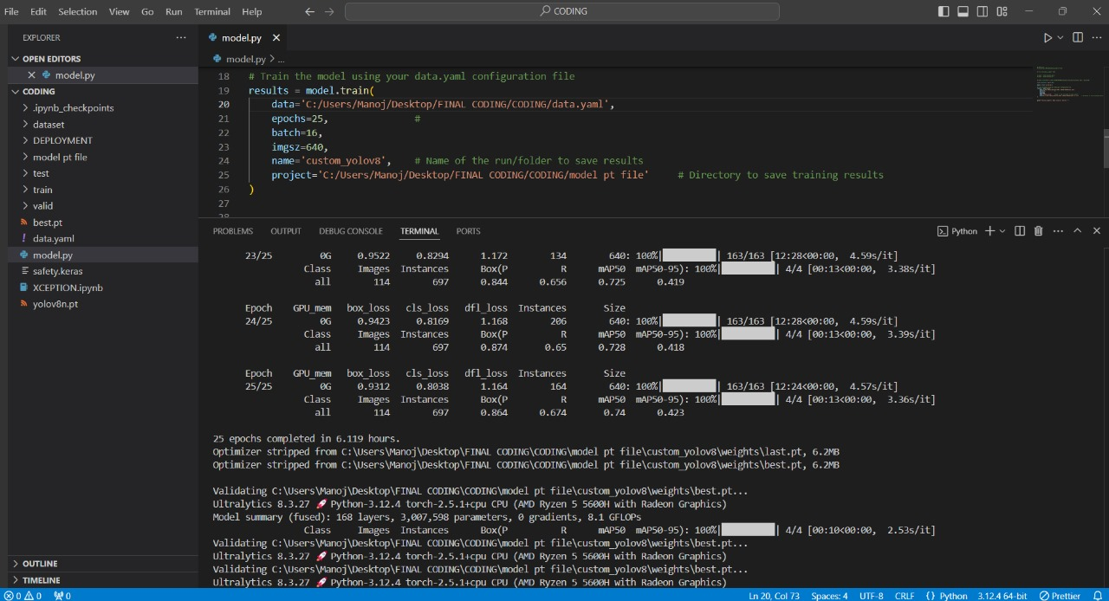
Implementation & Results
Data Collection and Training the model

Slide 12
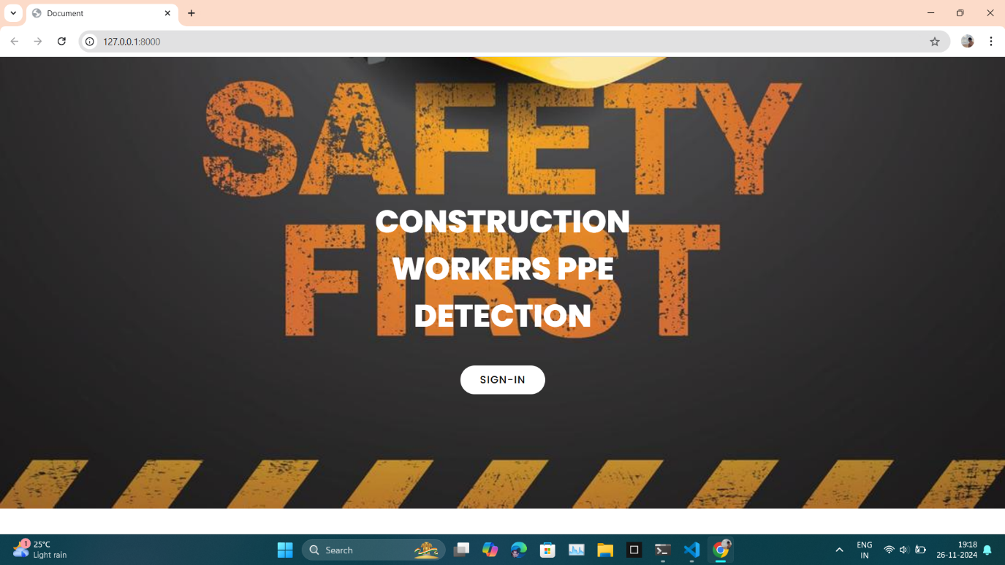
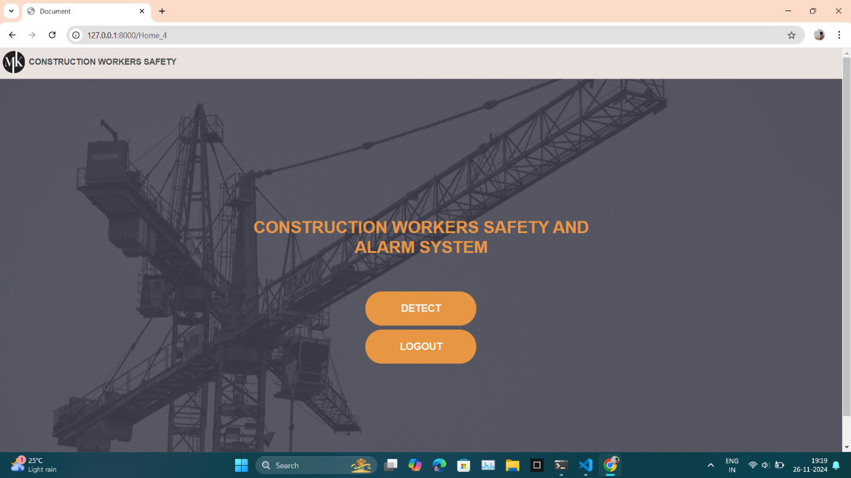
Implementation & Results
User Interface

Slide 13
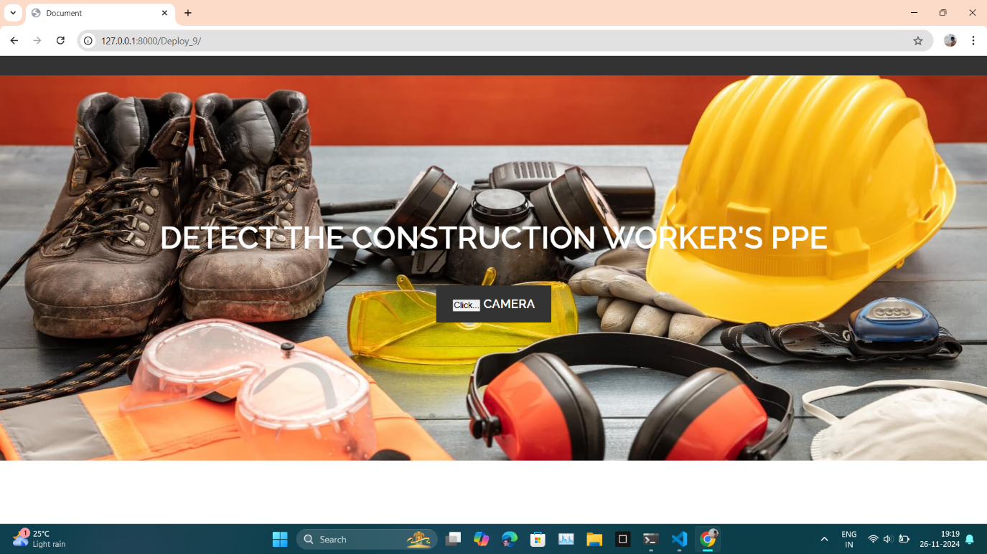
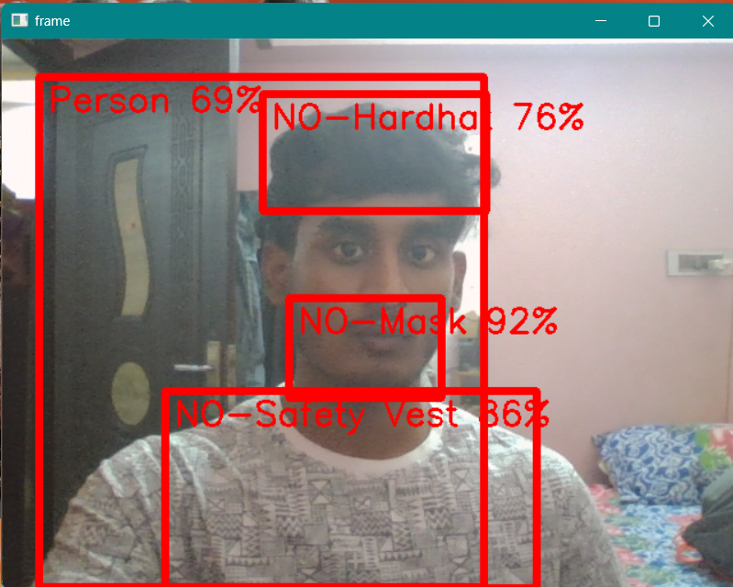
Implementation & Results
User Interface and PPE Detection

Slide 14
Conclusion
This project demonstrates an effective solution for ensuring PPE compliance on construction sites through real-time detection using YOLOv8 integrated with Django. By automating monitoring and triggering alerts for non-compliance, it fosters a proactive safety culture, significantly reducing workplace risks. Ultimately, it aims to create safer environments where workers are protected, ensuring they return home safely each day.
After training model.pt file is obtained after training the YOLOv8 model, it is integrated into a Django framework to connect with the user interface (UI). The UI, developed using HTML, CSS, and JavaScript, allows users to activate the detection process through a "Detect" button, triggering the webcam. The YOLOv8 model analyzes the live video feed to detect whether workers are wearing required PPE like helmets, vests, and masks. If non-compliance is detected, immediately triggers an audio alarm to alert workers and nearby personnel.

Slide 15
Work for Phase II
In phase two of the project, significant enhancements will be implemented to optimize the real-time PPE monitoring system. Advanced data augmentation techniques such as affine transformations, random erase, grid mask, and mosaic augmentation will improve the model's ability to generalize across diverse scenarios and handle occlusions effectively. Model optimization will include gradient clipping to stabilize training and dropout to prevent overfitting, ensuring better generalization to unseen data. Detected PPE violations will be stored in an SQLite database for efficient tracking, including details like time, location, and type of violation, facilitating long-term safety analysis. Automated report generation using tools like Python’s Pandas library will simplify the monitoring process by providing detailed Excel reports on violations, precision, recall, and other insights. These reports will assist supervisors and site managers in making data-driven decisions to improve safety compliance. Together, these enhancements aim to improve the system's performance, scalability, and effectiveness, ensuring robust safety measures at construction sites.

Slide 16
References
1.Zhao, Y., et al. "Deep Learning-Based Framework for Safety Equipment Detection." Journal of Construction Engineering and Management, vol. 145, no. 4, 2019.
2.Singh, R., and Kumar, A. "Enhancing Safety Gear Detection Using Deep Learning." International Journal of Advanced Research, vol. 8, no. 6, 2020, pp. 25-31.
3.Sreenivasaraja N, Marudhakavi V,Velmurugan G,"Innovative Method for Accident Prevention in Construction Sites with Virtual Reality Analysis",2023 3rd International Conference on Pervasive Computing and Social Networking (ICPCSN).

Slide 17
References
4.Zhang, L., et al. "Wearable Devices for Monitoring Construction Worker Safety." Safety Science, vol. 120, 2019, pp. 145-156.
5. Kumar P, V. K. S, P. L and S. Senthil Pandi, "Enhancing Face Mask Detection Using Data Augmentation Techniques," 2023 International Conference on Recent Advances in Science and Engineering Technology (ICRASET), B G NAGARA, India, 2023
6. Tang, Y. Yang, and C. Yan, “Safety helmet and mask detection at construction site based on deep learning,” College of Physics, Nanjing University of Aeronautics.

Slide 18
References
7.Romero, D., et al. "Real-Time Alert Systems in Construction Safety." Safety Science, vol. 130, 2020, pp. 104873.
8.V. Jayasree and M. N. Kumari, “IoT-based smart helmet for construction workers,” Department of Information Technology, I.F.E.T. College of Engineering, Villupuram, India.
9. Kumar P, Reshmy A K, Vinodh Kumar S, "Towards Precision Agriculture: Harnessing Deep Learning for Accurate Plant Disease Diagnosis." 2024 IC3IoT, Chennai, India, 2024.
10. Y. Liu and W. Jiang, "Detection of wearing safety helmet for workers based on YOLOv4," Engineering Department, Shanghai Polytechnic University, Shanghai, China.

Slide 19
Paper Publication Status
TITLE: Empowering Construction Workers Safety through Real Time Protective Equipment Monitoring and Alarm System
AUTHORS: Dr. P. Kumar, Dr. S Senthil Pandi, K Manoj Kanna, M Maria Joshin
PUBLICATION STATUS: Accepted in Conference. Need to be Presented
CONFERENCE: IEEE International Conference on Advancement in Communication and Computing Technology (INOACC)

Slide 20
Thank You

